Slide 1

18ECC302J
Microwave & Optical Communications
Unit-IV: Introduction to Optical Fibers
Session 1-2-3

Slide 2
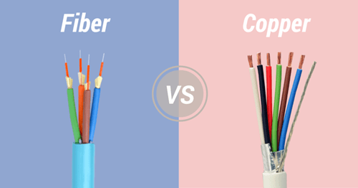
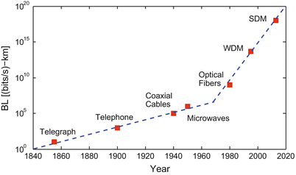
The “advantages” of Optical Fiber Communication over Copper Cables
Low transmission loss and wide band width
Small size and weight
Immunity to interference
Electrical isolation
Signal security
Abundant raw material
History of Communication
1970

Slide 3

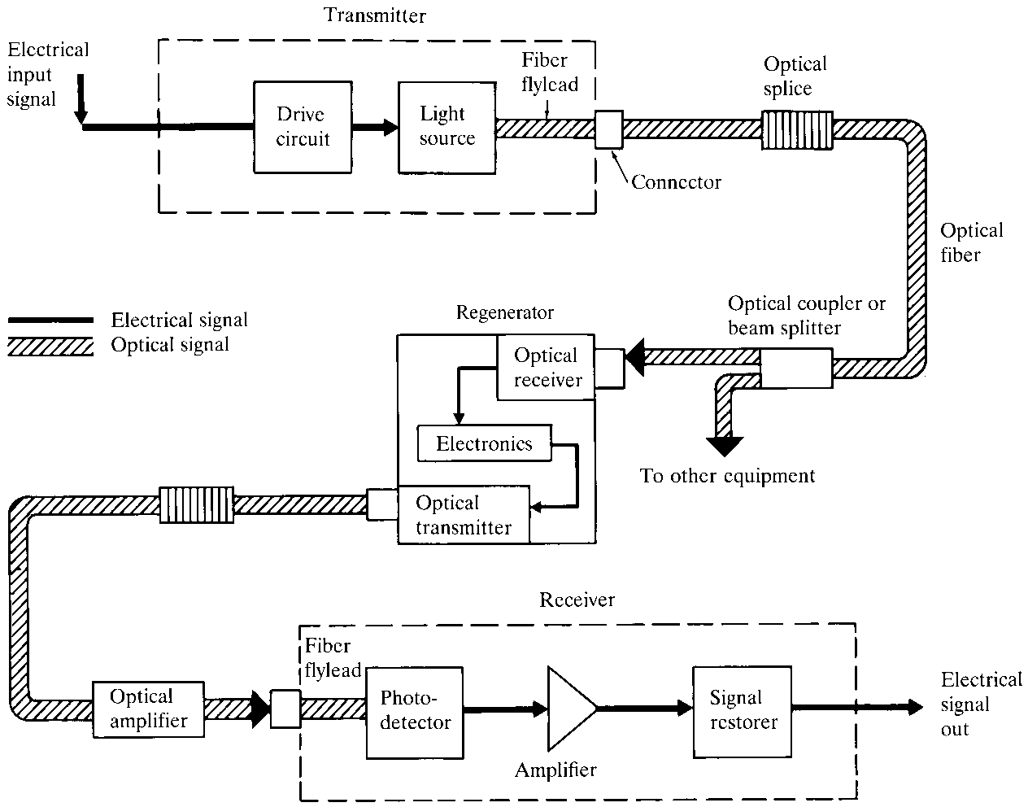
Elements of Optical fiber communication systems
The key elements
Transmitter consists of light source and its associate driver circuitary
Cable offering mechanical and environmental protection to optical fibers
Receiver consisting of a photo detector and amplification circuitary
Other additional components such as Optical amplifier, Regenerators, Connectors, Splices , Couplers and few passive and active photonic devices

Slide 4
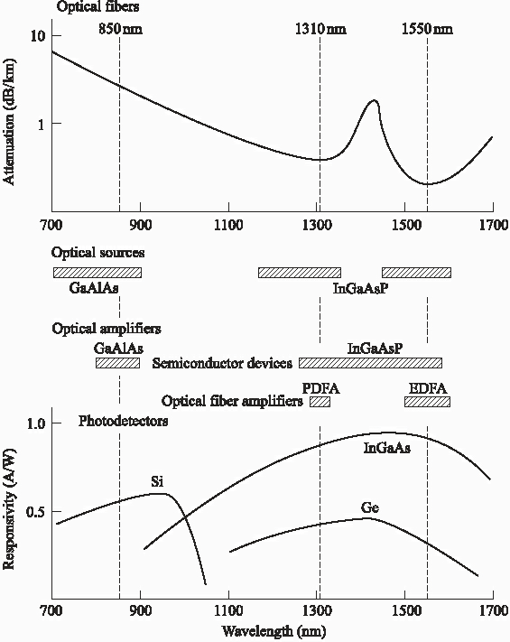
Elements of OPTICOM System
(Sources, Amplifiers, Detectors)
1970’s
1980’s onwards
Optical Sources
(Transmitters)
Optical Amplifiers
Optical Detectors (Receivers)
1970’s:
Limitation of sources and detectors (low band width)
1980’s onwards:
Exploitation of Near IR sources, detectors and fiber amplifiers etc.,

Slide 5
Elements of OPTICOM System
(Optical Transmitter )
Optical Transmitter converts the electrical information to optical format (E/O)
Light Emitting Diode (LED): cheap, robust and used with MMF in short range applications
Surface emitting and edge emitting LED
LASER Diode: high performance and more power, used with SMF in high speed links
Distributed Feedback (DFB) Laser – high performance single mode laser
Fabry-Perrot (FP) lasers – low performance multimode laser

Slide 6
Elements of OPTICOM System
(Optical Receivers, amplifiers )
Optical Receiver converts the optical signal into appropriate electrical format (E/O)
PIN Photo Diode: Low performance, no internal gain, low cost, widely used
Avalanche Photo Diode (APD): High performance with internal (avalanche) gain
Phototransistors: High performance with internal and external gain
Optical Amplifier: Amplifies light in fiber without O/E/O
Repeater: receives weak light signal, cleans-up, amplifies and retransmits (O/E/O)

Slide 7
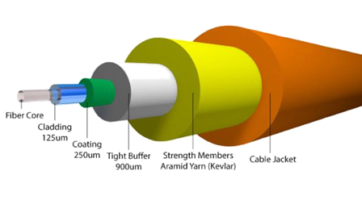
Elements of OPTICOM System
(Optical Fiber)
The Fiber –light carrier
Silica – Rigid less losses
PMMA – flexible more losses
Step Index Fiber – two distinct refractive indices
Graded Index Fiber – gradual change in refractive index
Single Mode Fiber offers the highest bit rate, most widely used
Multi Mode Fiber offers higher dispersion (due to multiple modes) cheaper than SMF, used in local area networks

Slide 8
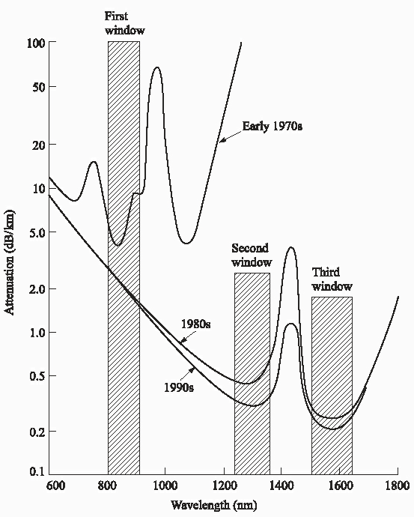
Attenuation characteristics of silica optical fiber
1970’s:
Si Fibers have local minima between 800-900 nm due to high water content
Limitation of sources and detectors (low band width)
1980’s:
Si Fibers have local minima between 1100-1600 nm due to removal of Hydroxyl ions and metallic impurities
Long wavelength region with two windows centered around 1300nm and 1550nm
Available sources and detectors for 1100-1600 nm
1990’s:
Lower the attenuation further

Slide 9
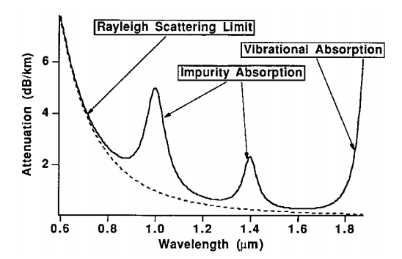
Details of attenuation characteristics of silica optical fiber

Slide 10
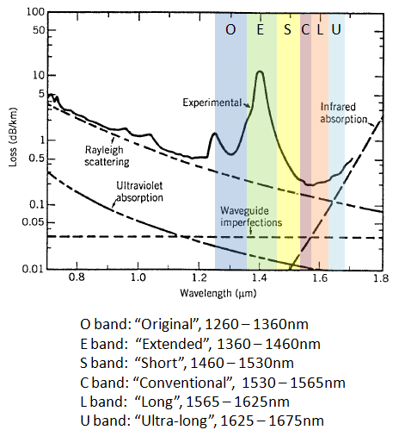
Details of attenuation characteristics and “Spectral bands”

Slide 11
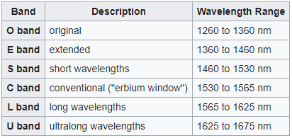
“Details of Spectral bands”
International Telecommunication Union (ITU)

Slide 12
“Details of Spectral bands”
850nm-band: It is the primary wavelength for multimode fiber optical communication systems
O-Band: The first wavelength band used for optical communication, because signal distortion (due to chromatic dispersion) is minimum. It was also because optical fibers produced in the mid 1970s showed its lowest loss near the O-band.
C-band: It is commonly used in many metro, long-haul, ultra-long-haul, and submarine optical transmission systems combined with the WDM and EDFA technologies.
L-band: It is the second lowest-loss wavelength band, and is a popular choice when the use of the C-band is not sufficient to meet the bandwidth demand.
S-band: The optical loss is lower than that of the O-band, and the S-band is used for many PON (Passive-Optical Network) systems as the downstream wavelength.
E-band is the least common wavelength band among the five. It is due to lowest attenuation among the five bands
U-band is mainly used for network monitoring purposes

Slide 13
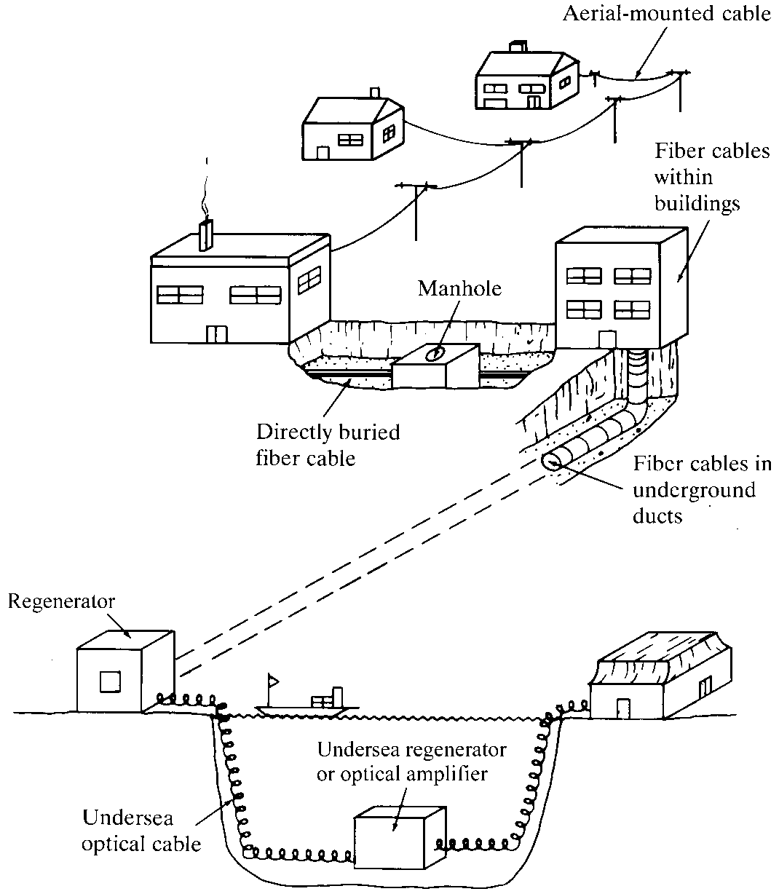
Installation types of optical fiber communication
Types of optical cable Installation
Areal Mounted cables
Carried through manholes and Inducts
Directly buried under the soil
Lay under the seabed or submerged
Optical fiber networks in buildings

Slide 14
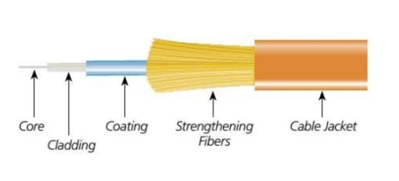
Optical fiber structure
Optical Fibers are the concentric cylindrical structured dielectric waveguides primarily designed to transport optical signal (a variety of structures are available now-a-days in market)
The most common fiber cable has an inner most material called core (High refractive index silica or PMMA) which is surrounded by cladding material with a slightly lower refractive index
Core and cladding are protected by two outer layer such as strengthening fibers and the jacket

Slide 15
Optical fiber structure
The Jacket provides mechanical strength and protects from breakages and also protect from moisture from atmosphere.
The strengthening fibers inside the jacket is to increase the tensile strength of the fiber

Slide 16
Light propagation in Optical fibers
Light Wave Theories
Different theories explain light behaviour
We will first use ray theory to understand light propagation in multimode fibres
Then use electromagnetic wave theory to understand propagation in single mode fibres
Quantum theory is useful to learn photo detection and emission phenomena

Slide 17
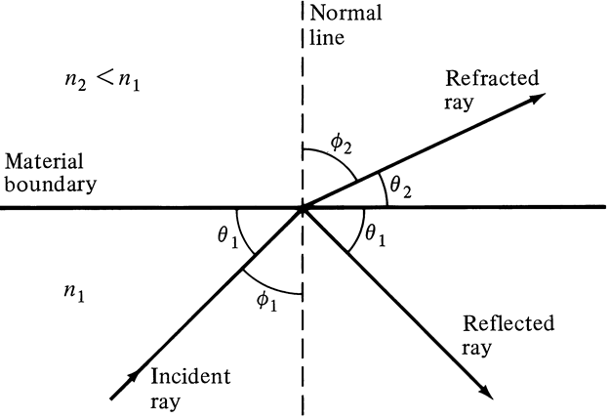
Light propagation in Optical fibers
(working phenomenon)
Reflection and Refraction
Snell’s Law: n₁ Sin Φ₁ = n₂ Sin Φ₂
When Φ₂ = 90, Φ₁ = Φc
Which is the Critical Angle Φc=Sin⁻¹(n₂/n₁ )

Slide 18
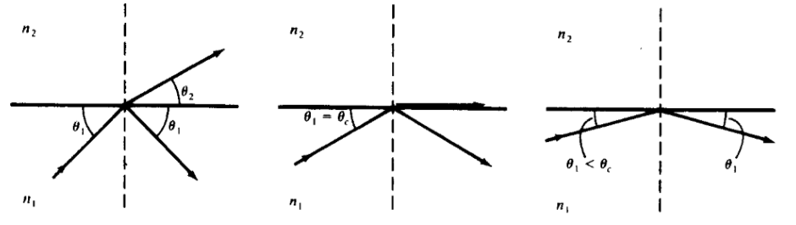
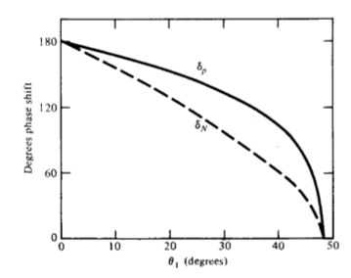
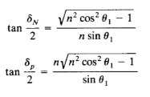
Light propagation in Optical fibers
(working phenomenon)
Reflection and Refraction
Critical Refraction
Total Internal Reflection
In TIR there is a phase change in refracted ray in normal and parallel component

Slide 19
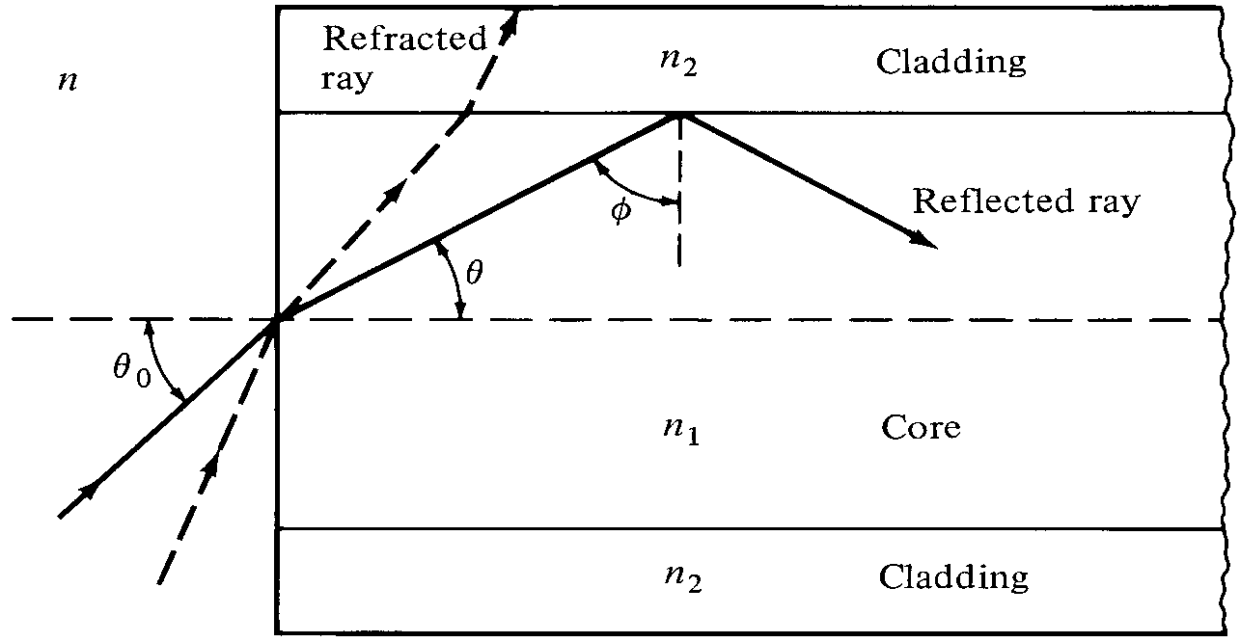

Light propagation in Optical fibers
(Propagation of light : meridonal ray)
A meridonal ray or tangential ray is a ray that is confined to the plane containing the system's optical axis and the object point from which the ray originated
Numeric aperture (NA) is defined as the light acceptance capacity for a fiber to calculate source-to-fiber coupling efficiency

Slide 20
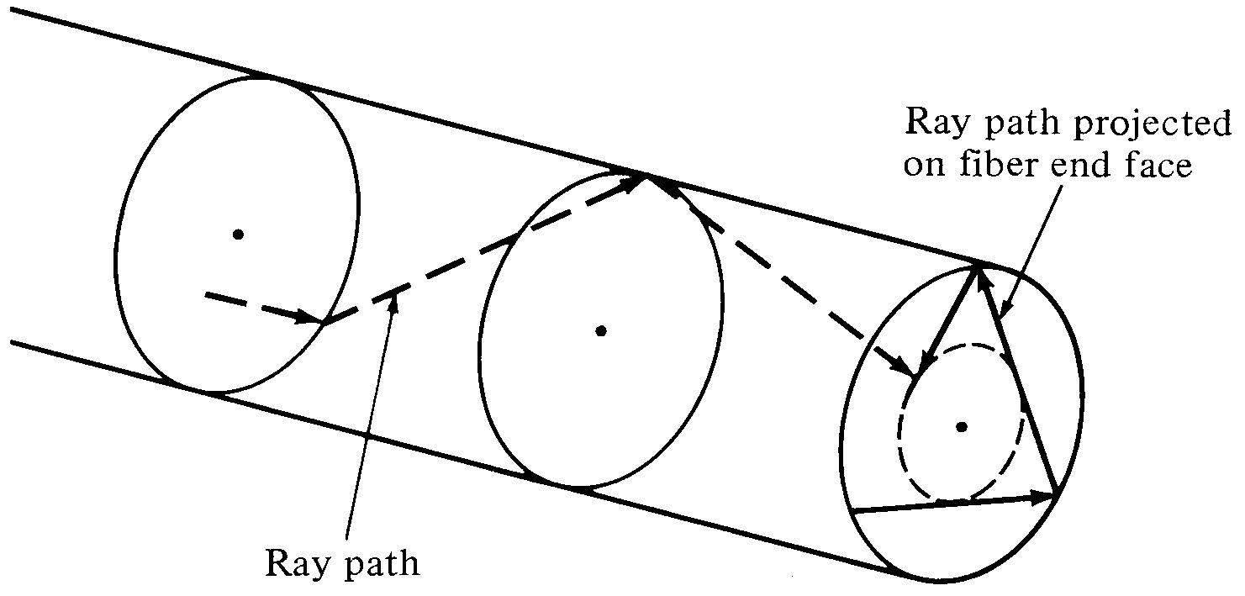
Light propagation in Optical fibers
(Propagation of light: Skew ray)
A skew ray is a ray that does not propagate in a plane that contains both the object point and the optical axis. Such rays do not cross the optical axis anywhere, and are not parallel to it

Slide 21
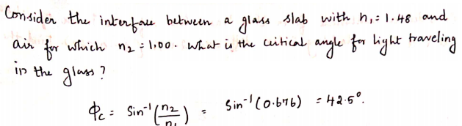
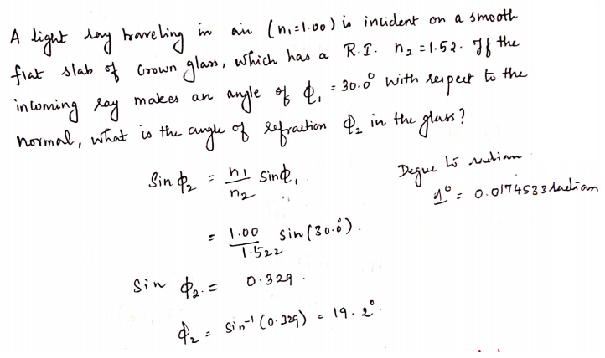
Exercise Problems

Slide 22
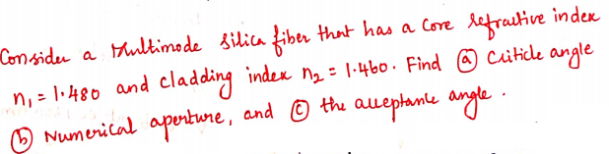
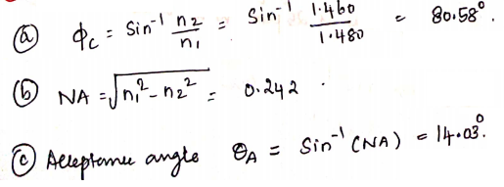
Exercise Problems

Slide 23

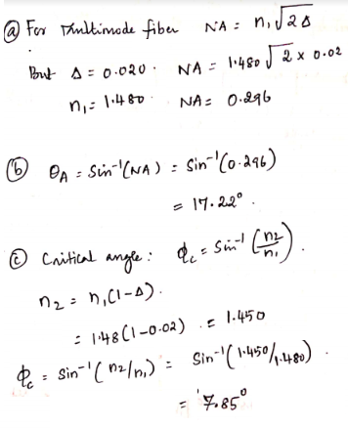
Exercise Problems

Slide 24
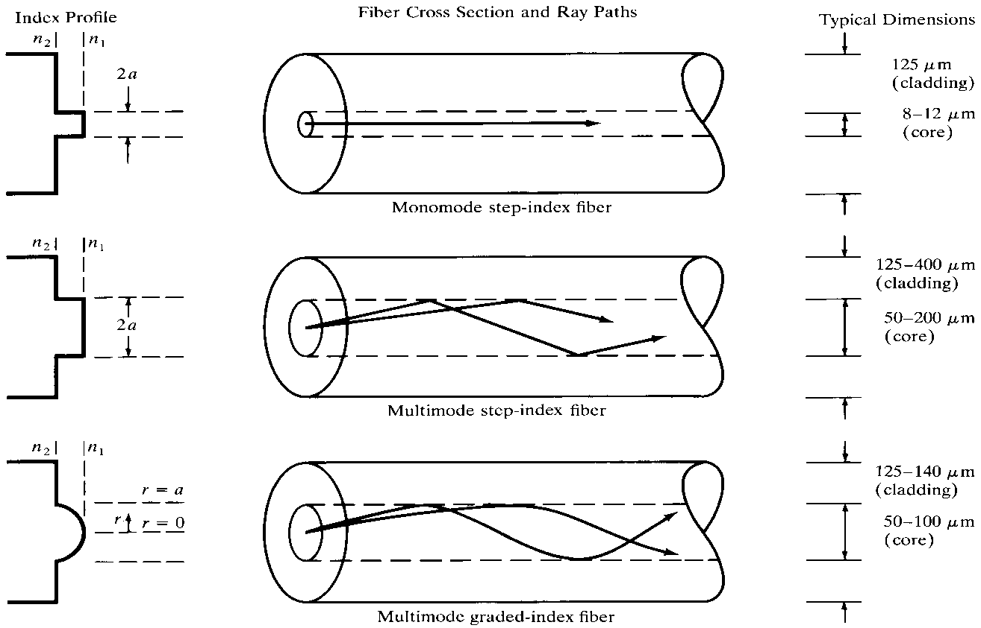
Overview of Modes in Optical fiber
Ray theory show only the number of propagating light rays based on which one will derive understanding of single mode and multimode fibers
Mode theory explains the optical power propagation mechanism in a fiber

Slide 25
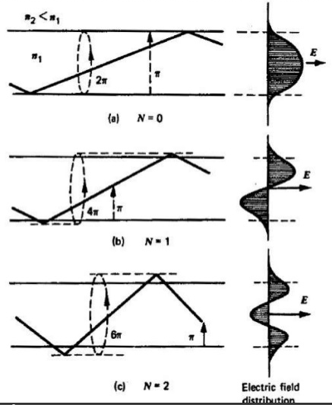
Overview of Modes in Optical fiber
Solutions to the Maxwell electromagnetic equations in cylindrical coefficient format gives rise to the various distribution of optical power in transvers direction to the propagation (which is around the optical axis)
The cross section view of field distribution represented in two dimensional picture show modes
Number of field minima across the fiber core gives the order of the mod

Slide 26
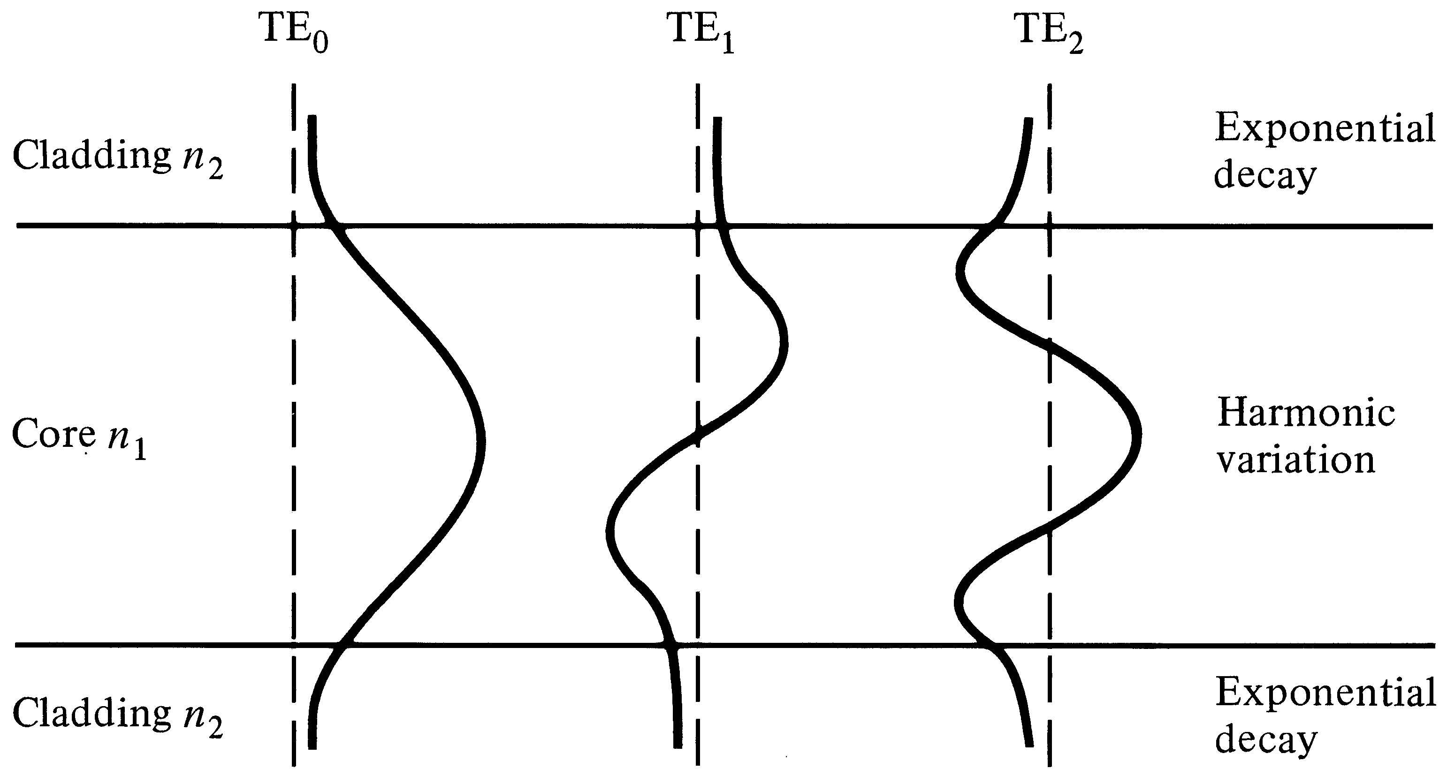
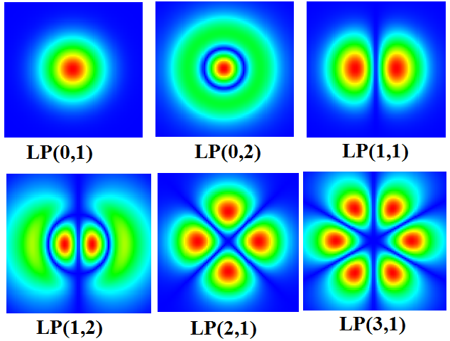
Overview of Modes in Optical fiber
Standing waves in transvers direction
Cross sectional Field distribution

Slide 27
Cutoff wavelength
The number of guided modes in an optical fiber depends on the optical wavelength
The shorter the wavelength, the more modes can be guided.
For long wavelengths, there may be only a single guided mode
(→ single-mode fibers) or even none at all
Multimode behavior is obtained at shorter wavelengths.
The minimum wavelength at which an optical fiber support single mode is called cut off wavelength.
Above the cutoff wavelength only LP₀ modes propagate
Below the cut off wavelength other LP₁₁ and higher modes propagates.

Slide 28

V-Number
Each mode that propagates along the optical fiber satisfying all the phase conditions inside the optical fiber.
Each propagating mode has a corresponding frequency, below which the mode cannot propagate
This frequency of the mode is called its cut-off frequency
For a particular mode to propagate inside the fiber, the V-number (normalized frequency) of the fiber must be greater than the V-number corresponding to the cut-off frequency of the mode.
In an optical fiber, the normalized frequency( V number), is given by

Slide 29
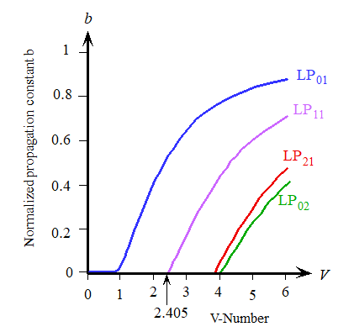


Number of Modes supported by fiber
Number of Modes for Step Index Fiber:
Number of Modes for Graded Index Fiber:
V< 2.405 Single mode fiber
V>2.405 Multimode fiber

Slide 30
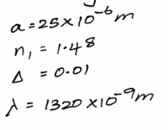
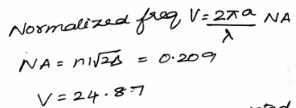
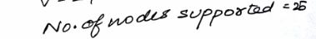

Exercise Problems
Q. Calculate normalized frequency for given core radius 25 um index of core 1.48 delta =0.01 lamda=1320nm. Calculate number of modes supported in this fiber?

Slide 31
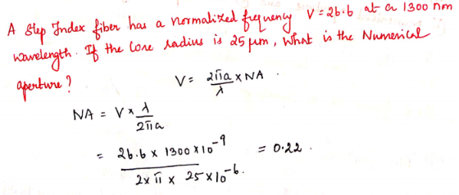
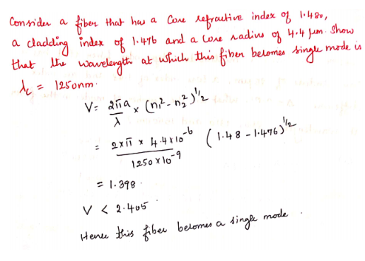
Exercise Problems

Slide 32
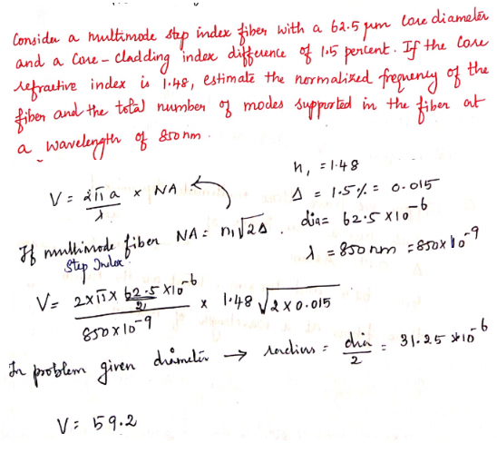
Exercise Problems

